Slide 1
Category review: Chips
June 2020
Retail Analytics
Brand note: If client logo is not required, use alternate title page layout right click slide thumbnail > Layout > Title

Slide 2
Notes:
To view Privacy video explaining how important data privacy is to Quantium, please click here: https://www.youtube.com/watch?v=Zq1QDAkoRzU
or here Q:\Company Reference\Brand & Design\Brand videos\Q Privacy.mp4
At Quantium, we believe that data is the behavioural footprint of humanity and that it has to be treated with the utmost care and responsibility.
Histories, attitudes, indeed lives are stored within it in ways that aren’t always apparent – and that’s what makes its potential so powerful.
To work with it responsibly, sensitively, we set ourselves the highest data privacy protection and governance standards.
We have spent 17 years perfecting privacy-by-design and secure-by-design principles. Central to this is not holding any personally identifiable information about people –
we neither receive it, and put the necessary protections in place to be unable to decipher it.
Every aspect of handling data is safeguarded: from its de-identification, to its encryption – data security is paramount and of the highest grade.
We pride ourselves on gaining the trust of iconic organisations around the world through years of securely working with their data,
and in turn the trust that builds with their stakeholders.

Slide 3
Executive summary
01
Task 1
Costumer segmentation on the basis of life stage and premium status.
Diverse products(114 product names).Top products are mostly from Kettle and Cobs brands.
Transaction information
89% of transactions involved purchase of 2 items.
Over 264,000 transactions across 272 stores.
The high volume of purchases from Retirees and Older Singles/Couples suggests these could be strong target segments for promotions or product bundling.
Mainstream costumers dominate the premium status.
Histograms of Life stage and Premium status provide insights.
02
Task 2
Fields include: purchase date, store number, customer ID, product details, sales, brand, pack size, life stage, and customer premium status
It includes neither null nor missing values in essence data is complete and organized.
Data was transformed to weekly summary of the stores .This weekly-level view supports temporal comparison for trial-control store analysis.
Trial stores analyzed 77, 86 and 88.
Custom function ranks potential control stores by combining: correlation and magnitude difference.
The pre-trial period used (e.g., June 2018 to Jan 2019) is essential in ensuring control store selection is based only on historical, unbiased data.

Slide 4
01
Costumer Segmentation
Product Performance Analysis
Subcategories-
Descriptive Analysis, EDA(Exploratory Data Analysis), Market Segmentation, Costumer Behaviour Analysis and Purchase Patterns Insights.

Slide 5
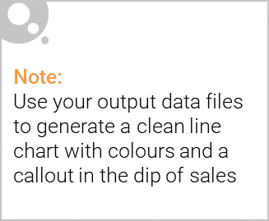
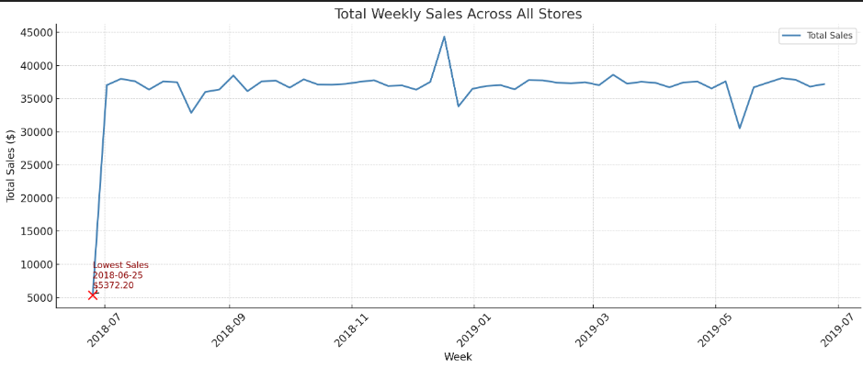
Weekly sales show consistent performance with a noticeable dip during the week of [lowest sales date]. This decline may indicate external factors such as seasonality, stock issues, or reduced promotions. Monitoring such dips can help identify patterns and plan for demand fluctuations.

Slide 6

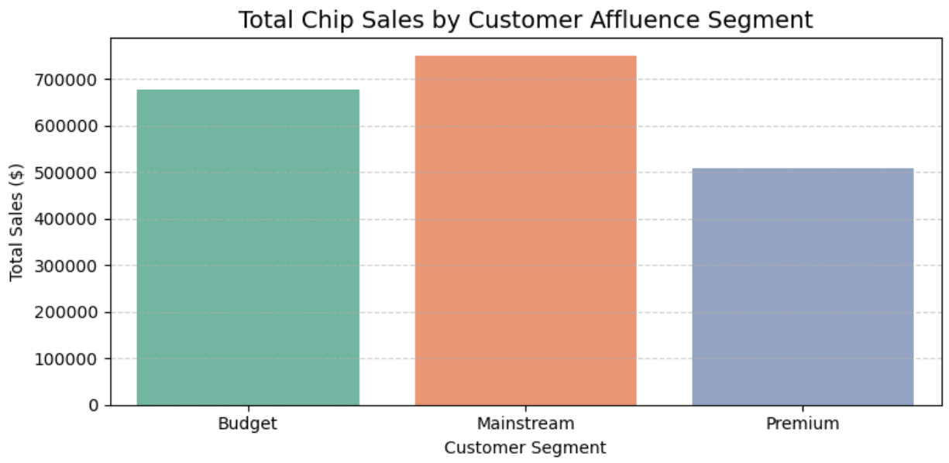
Mainstream costumers dominate volume; Premium costumers indicate brand loyalty and quality preference and Budget costumers focus on quantity of deals.

Slide 7
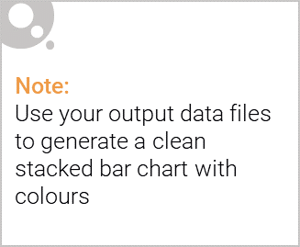
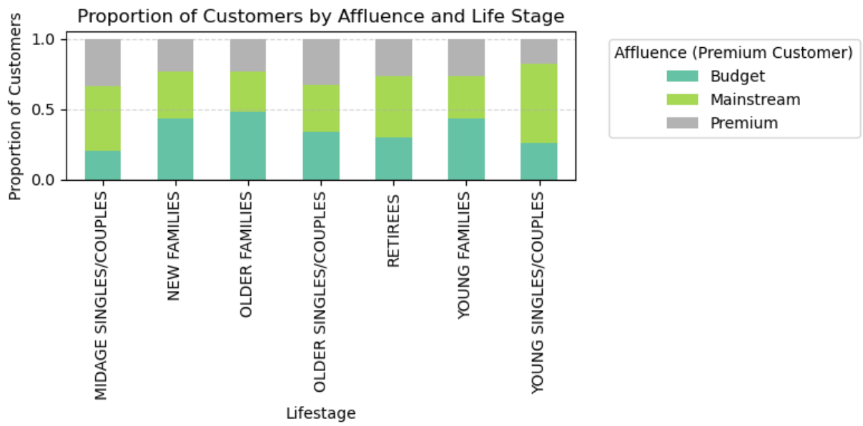
Editable (delete this)
Customer affluence varies significantly by life stage, with mainstream affluence dominating most segments. Family segments lean budget-conscious, while mid-age and older singles/couples show greater premium potential. This suggests marketers should tailor product pricing and promotions by both life stage and affluence to maximize effectiveness.

Slide 8
02
Trial store performance
Performance Analysis

Slide 9
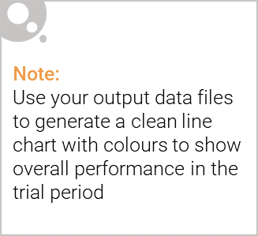
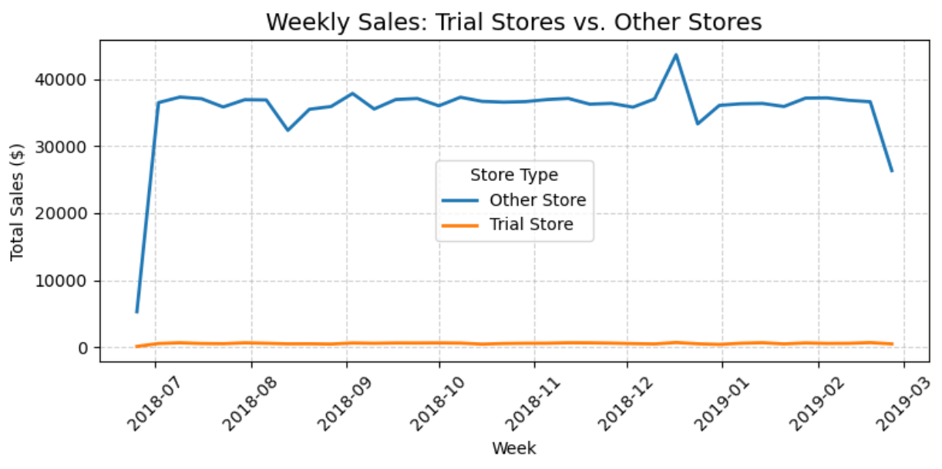
Control stores are selected specifically because they closely mirror the trial store’s behavior before the trial, whereas other stores are not used for direct comparison and may differ significantly in sales patterns or customer profiles.

Slide 10
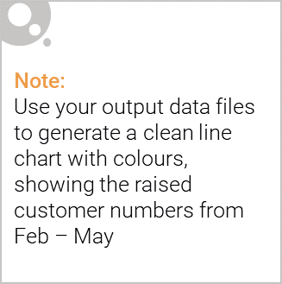
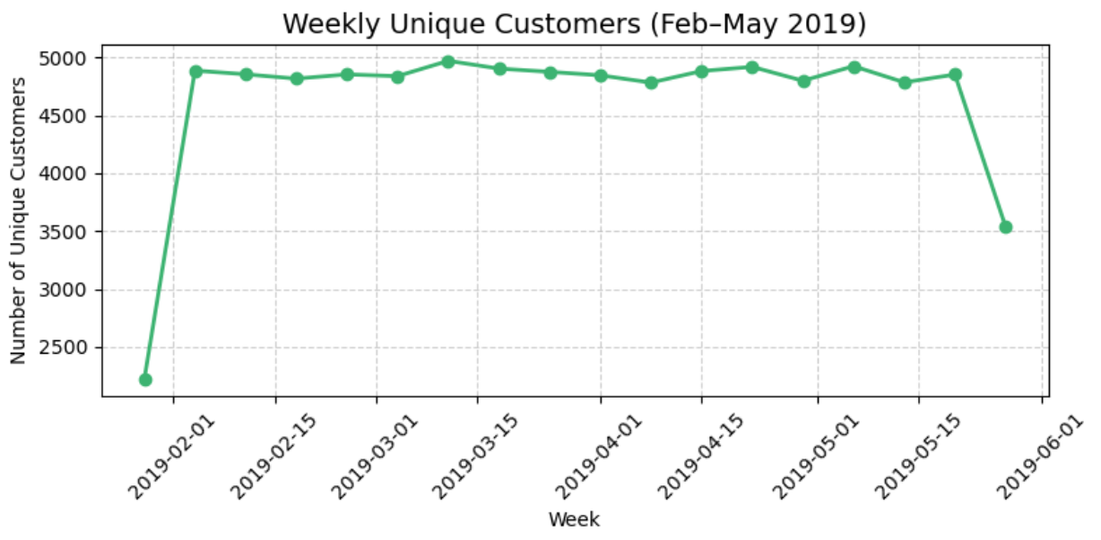
The trial stores showed a noticeable uplift in total weekly sales during the trial period compared to control or other stores. This indicates that the trial had a positive impact on customer spending behavior. The increase was sustained over multiple weeks, suggesting effectiveness beyond short-term spikes. Therefore, the trial can be considered successful based on sales performance.

